Slide 1





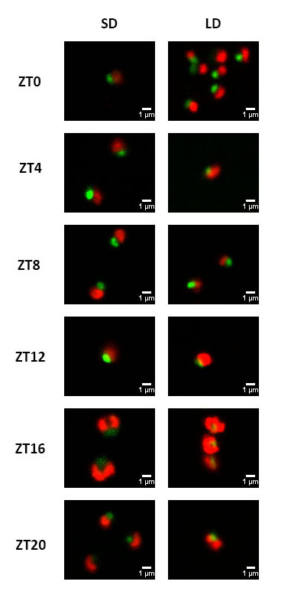










(A)
G1 Phase
S Phase
G2 Phase
% of Cells
% of Cells
% of Cells
G1
S
G2|M
G1
S
G2|M
G1
S
G1
S
G2|M
G1
S
G2|M
G1
S
G1
S
G2|M
G1
S
G2|M
G1
S
G1
S
G2|M
G1
S
G2|M
G1
S
G2|M
G1
S
G2|M
G1
S
G2|M
G1
S
G2|M
G1
S
G2|M
G1
S
G2|M
G1
S
G2|M
(B)
LD G1 Phase
LD G2 Phase
G1 Phase
Cells
G2 Phase
Cells
(G)
G1 Phase
Proteins
G2 Phase
Proteins
G1 Phase
Genes
G2 Phase
Genes
G2|M
G1
S
G2|M
G1
S
SD G1 Phase
SD G2 Phase
G1 Phase
Cells
G2 Phase
Cells
G1 Phase
Proteins
G2 Phase
Proteins
G1 Phase
Genes
G2 Phase
Genes
G1
S
G2|M
G1
S
G2|M
(C)
(D)
(E)
cycA
cycB
cycD
cdkA
CDKA
Gene Expression (FPKM)
G2|M
G1
S
G2|M
G1
S
G2|M
G1
S
cycA
cycB
cycD
cdkA
CDKA
Gene Expression (FPKM)
G1
S
G2|M
G1
S
G2|M
G1
S
G2|M
(F)
G2|M
G1
S
G1
S
G2|M

Slide 2
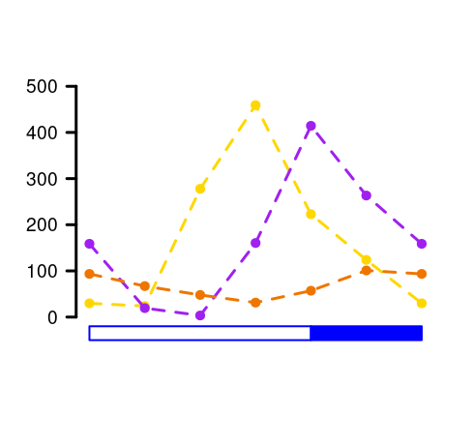
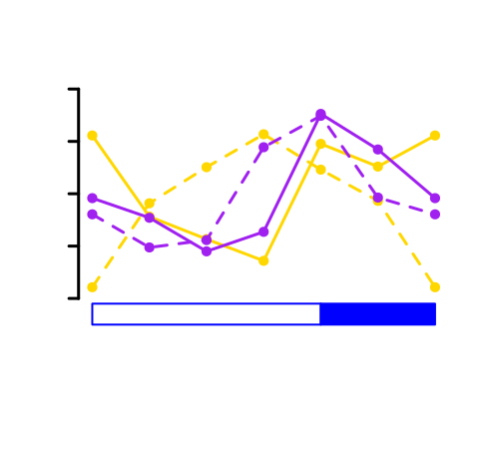
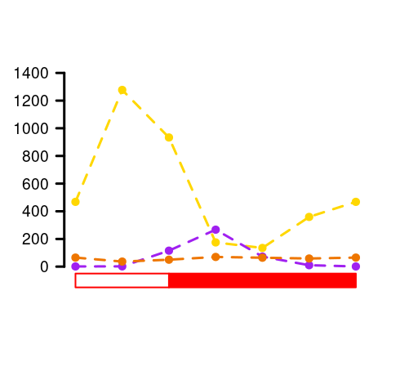
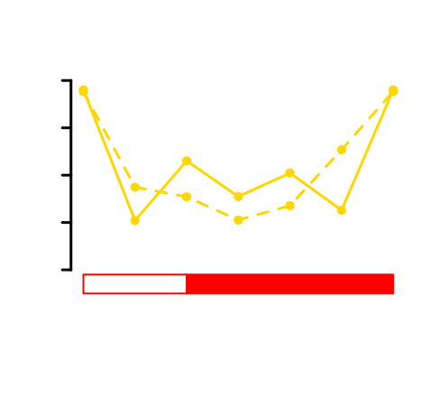
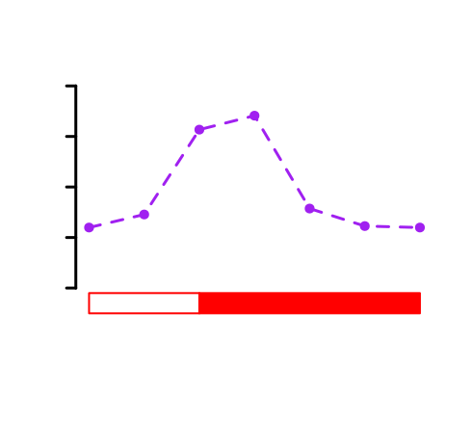
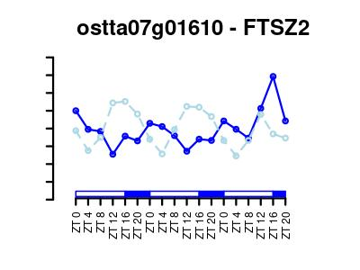
(A)
G1 Phase
S Phase
G2 Phase
% of Cells
% of Cells
% of Cells
G1
S
G2|M
G1
S
G2|M
G1
S
G1
S
G2|M
G1
S
G2|M
G1
S
G1
S
G2|M
G1
S
G2|M
G1
S
G1
S
G2|M
G1
S
G2|M
G1
S
G2|M
G1
S
G2|M
G1
S
G2|M
G1
S
G2|M
G1
S
G2|M
G1
S
G2|M
G1
S
G2|M
(B)
LD G1 Phase
LD G2 Phase
G1 Phase
Cells
G2 Phase
Cells
G1 Phase
Proteins
G2 Phase
Proteins
G1 Phase
Genes
G2 Phase
Genes
G2|M
G1
S
G2|M
G1
S
SD G1 Phase
SD G2 Phase
G1 Phase
Cells
G2 Phase
Cells
G1 Phase
Proteins
G2 Phase
Proteins
G1 Phase
Genes
G2 Phase
Genes
G1
S
G2|M
G1
S
G2|M
(C)
(C)
(D)
Gene Expression (FPKM)
G2|M
G1
S
G2|M phase
G1 phase
S phase
Gene Expression (FPKM)
G1
S
G2|M
G1 phase
S phase
G2|M phase
G1 phase
S phase
G2|M phase

Slide 4
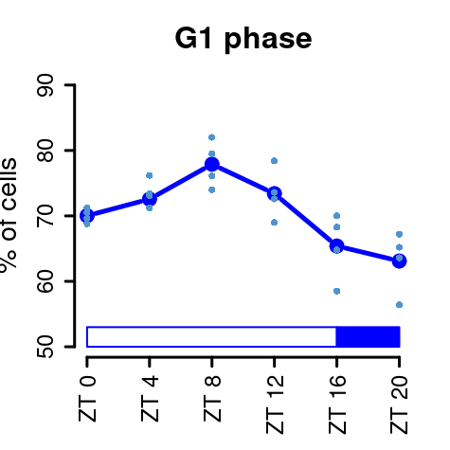
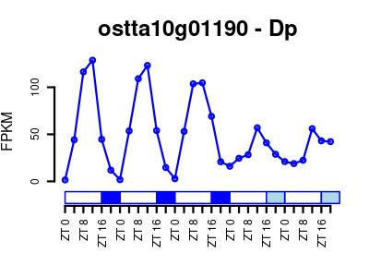
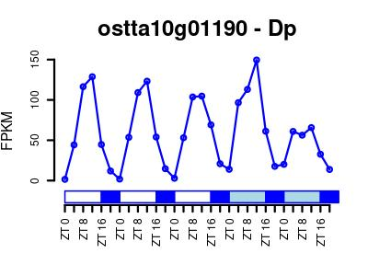
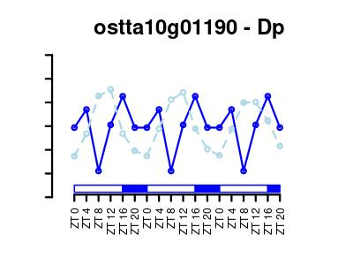
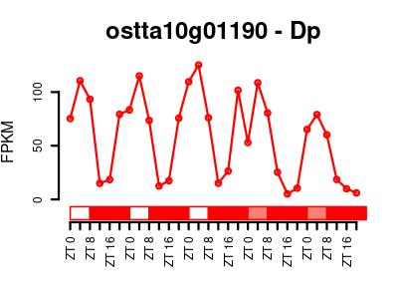
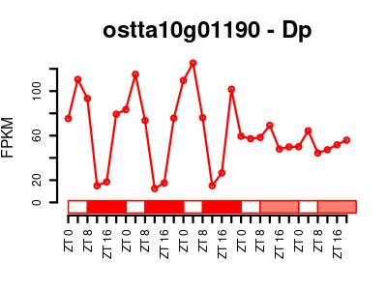
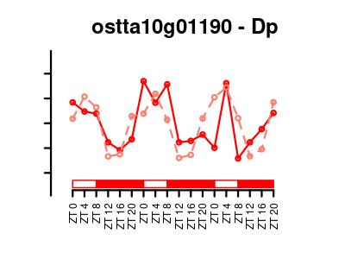
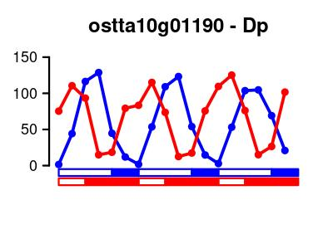
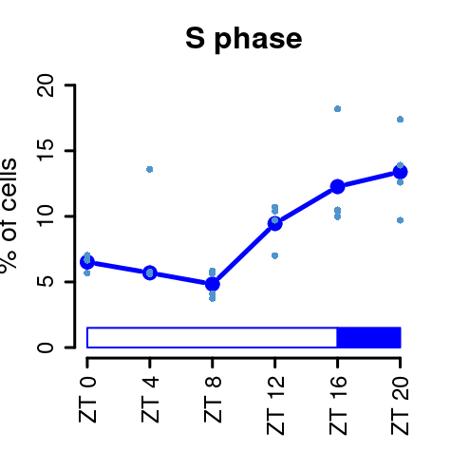
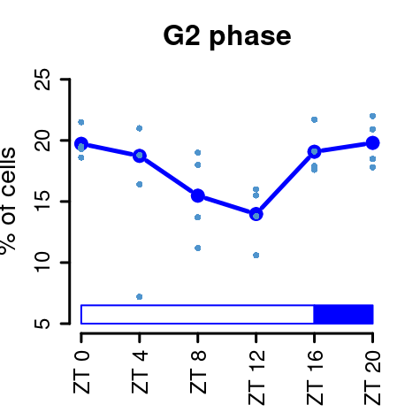
G1
G2

Slide 5
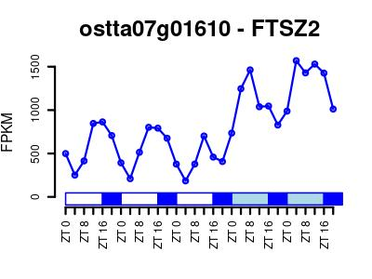
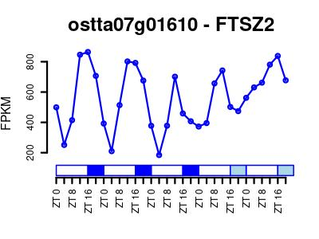
Chartreuse3 darkgoldenrod3 mediumorchid2

Slide 6
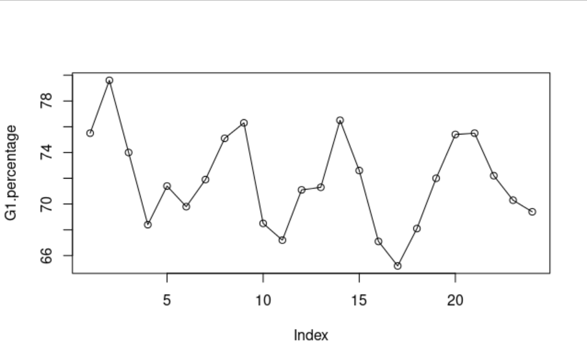
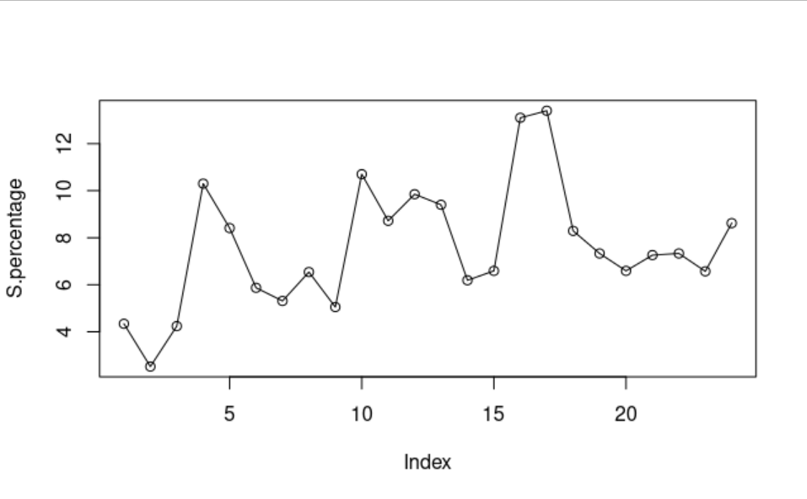
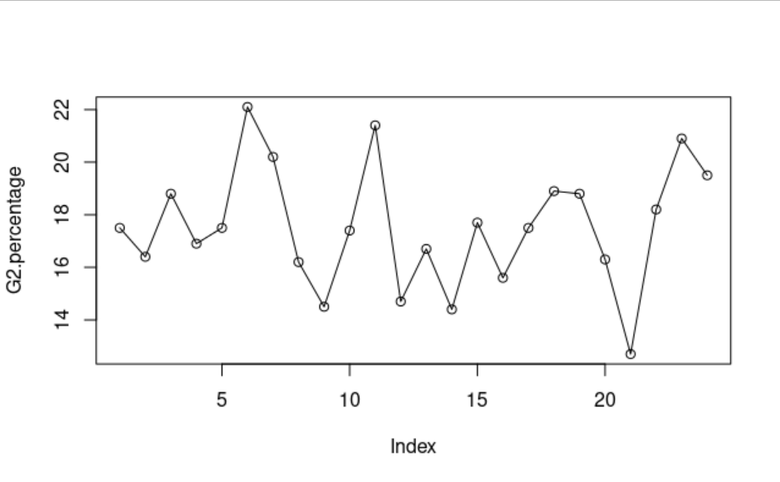

Slide 7
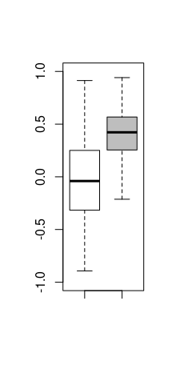
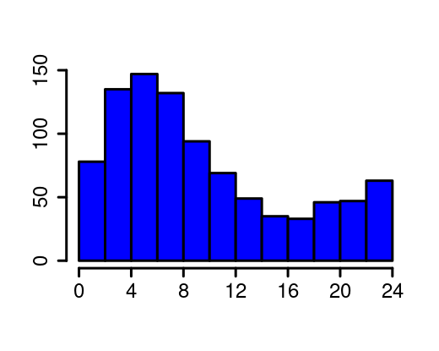
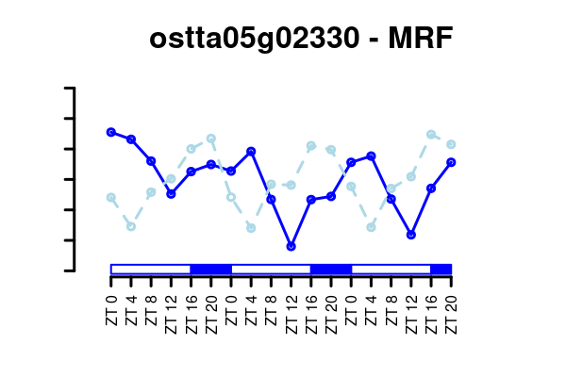
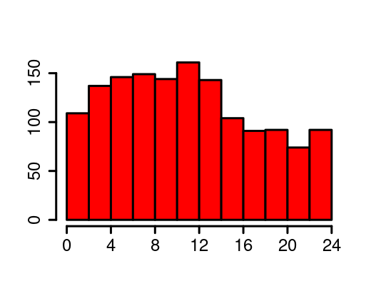
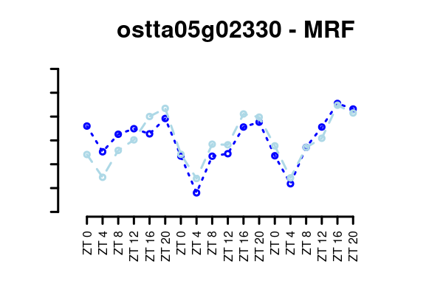
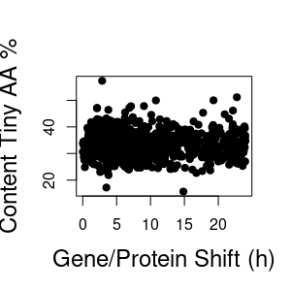
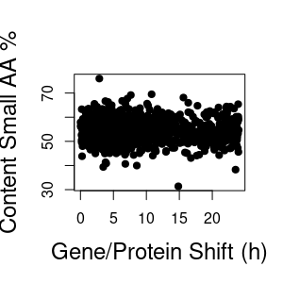
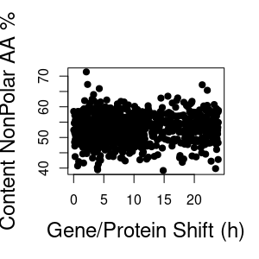
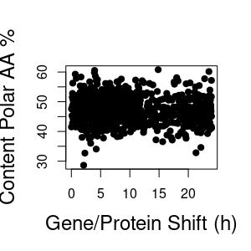
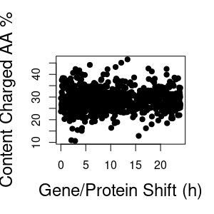
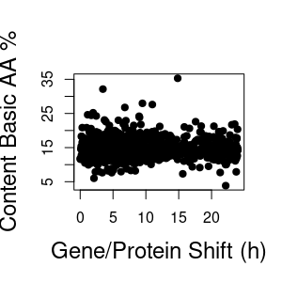
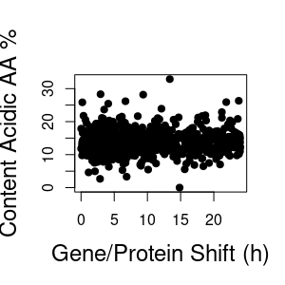
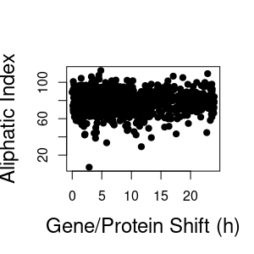
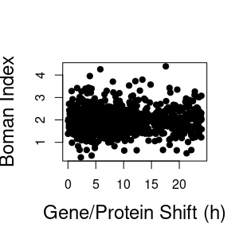
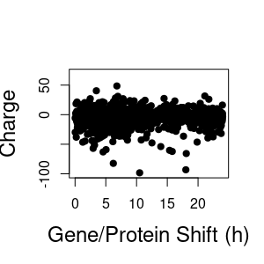
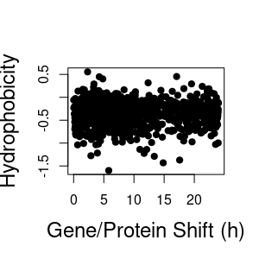
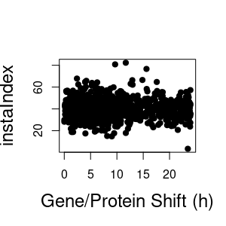
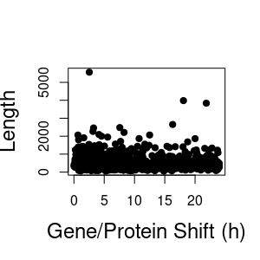
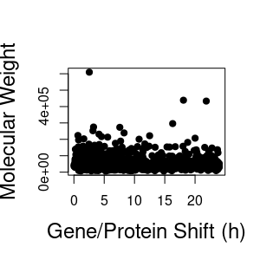
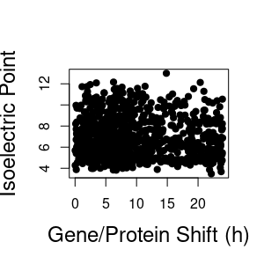
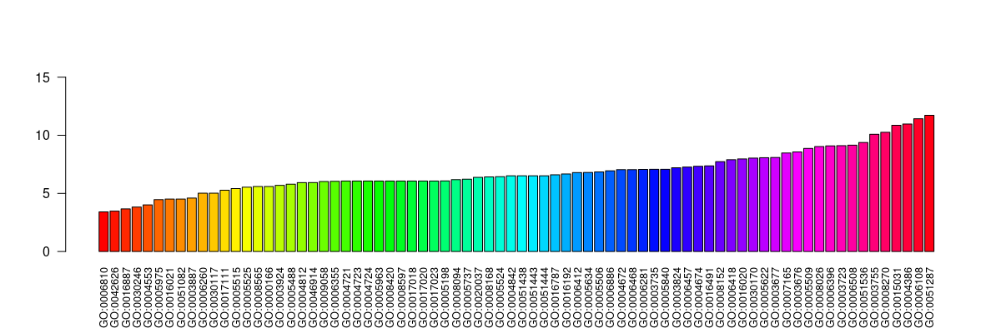
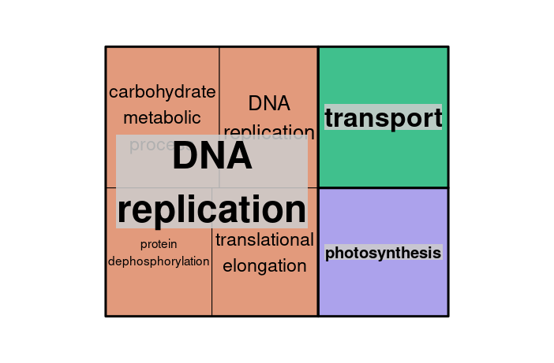
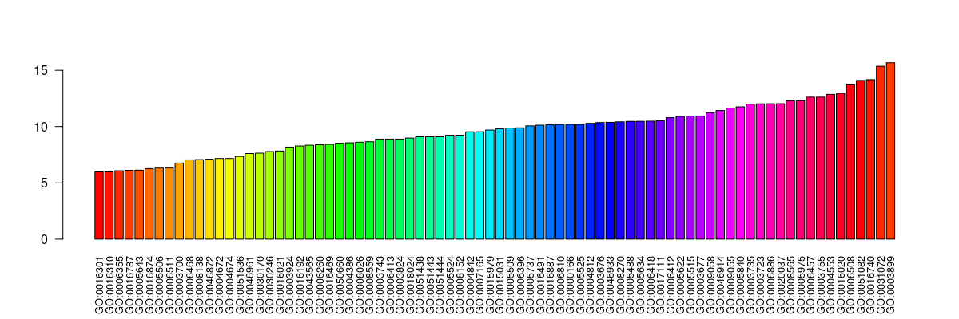
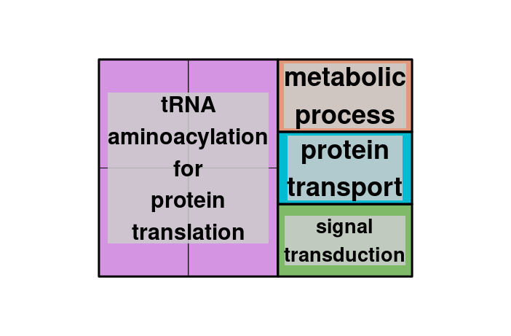
(A)
(B)
(C)
Number of Proteins
Protein/Gene Profiles Correlation
Correlation -0.34
Protein/Gene Offset (h)
Number of Proteins
Original Out of
Phase Profiles
Shifted Phase Aligned Profiles
0.8368383
Protein/Gene Offset (h)
(D)
Protein/Gene Offset (h)
Protein/Gene Offset (h)
Protein/Gene Offset (h)
Protein/Gene Offset (h)
Protein/Gene Offset (h)
Protein/Gene Offset (h)
Protein/Gene Offset (h)
Protein/Gene Offset (h)
Protein/Gene Offset (h)
Protein/Gene Offset (h)
Protein/Gene Offset (h)
Protein/Gene Offset (h)
Protein/Gene Offset (h)
Protein/Gene Offset (h)
Protein/Gene Offset (h)
(E)
(F)
Protein/Gene Offset
Median (h)
Gene Ontology Term
Protein/Gene Offset
Median (h)
Gene Ontology Term

Slide 8
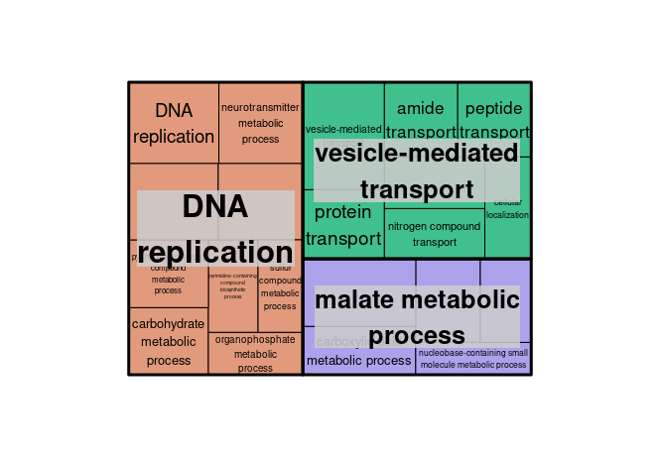
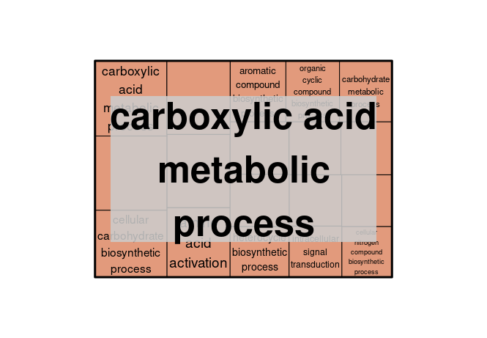
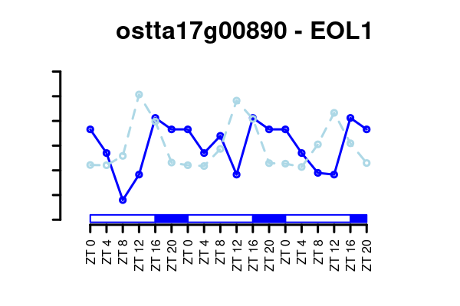
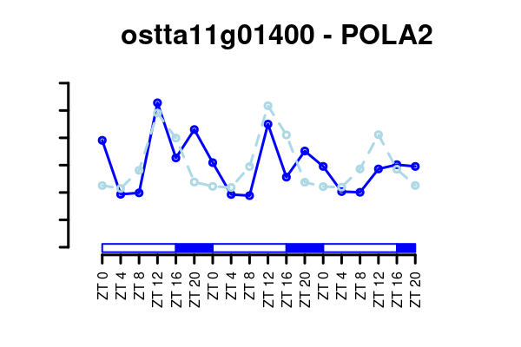









Slide 9




Slide 10
Protein/Gene Offset (h)
Protein/Gene Offset (h)
Protein/Gene Offset (h)
Protein/Gene Offset (h)
Protein/Gene Offset (h)
Protein/Gene Offset (h)
Protein/Gene Offset (h)
Protein/Gene Offset (h)
Protein/Gene Offset (h)
Protein/Gene Offset (h)
Protein/Gene Offset (h)
Protein/Gene Offset (h)
Protein/Gene Offset (h)
Protein/Gene Offset (h)
Protein/Gene Offset (h)
*
*
*
*

